Slide 1

Toss Time
October 11th
Team Name: Sinked Inc.
Member Names:
Kenny Blum Scrum Master
Cole Hennig Product Owner
Anton Kozintsev
Ryan Ahrari
Steve Beurard

Slide 2
Toss Time
An opportunity to bring people together who love beer and games!
Beer Dye is a very popular game amongst college students, and a networking app for finding games could help many young students have fun and make friends.

Slide 3
Project Scope
High level goal(s)
Be able to view a map of nearby games on the app
Be able to create and post table profiles on map
Be able to create a profile for yourself
Tournament posting page

Slide 4
Sprint 1
Sprint 1
  User stories (Be able to view a map of nearby games on the app)
  “As a dye player, I want to be able to see dye games around me, so that I can play more.”
  “As a table owner, I want the ability to post public marked locations, so I can show that I have a table available.”
  “As a dye player, I want the map centered around my location, so it will be easier to find games around me”
  Spikes (exploratory work, usually in preparation of future sprints)
  Research on Google Maps Proximity
  Infrastructure tasks (acquiring tools, setting up environment)
  Acquiring API Key to use google maps, learning how to customize it to our needs.

Slide 5
Sprint 2
Sprint 2
  User stories (Be able to create and post table profiles on map)
  “As a dye player, I want to see if a house has good house rules so that I would enjoy playing there.”
  “As a table owner, I want to be able to attach a table profile to a location on a map.”
  “As a table owner, I want to be able to attach a set of rules to a table post on a map.”
  “As a table owner, I want to be able to attach a picture of my table to my post on a map”
  Spikes (exploratory work, usually in preparation of future sprints)
  Research into database systems for user profiles
  Infrastructure tasks (acquiring tools, setting up environment)
  MySQL Research

Slide 6
Sprint 3
Sprint 3
  User stories (Be able to create a profile for yourself)
  “As a dye player, I want to see other players' stats and show off my own so that I can find players who are at my skill level.”
  “As a dye player, I want to create an account with my player profile so that people could see info about me”
  “As a dye player, I want to attach a player profile to a table I own so that people know it’s my table”
  “As a dye player, I want to have the ability to list and change stats and show competitiveness level, so I can customize my experience to cater towards people my skill level”
  Spikes (exploratory work, usually in preparation of future sprints)
  To Be Determined
  Infrastructure tasks (acquiring tools, setting up environment)
  PHP Research

Slide 7
Sprint 4
Sprint 4
  User stories (Tournament posting page)
  “As a dye player, I want to see if there are any tournaments to play so that I could have a good day of dye.”
  “As a table owner, I want to be able to list my table for an open tournament.”
  “As a tournament hoster, I want to be able to see who wants to play.”
  Spikes (exploratory work, usually in preparation of future sprints)
  To Be Determined
  Infrastructure tasks (acquiring tools, setting up environment)
  Acquiring API Key to use google maps, learning how to customize it to our needs.
  Final Version

Slide 8
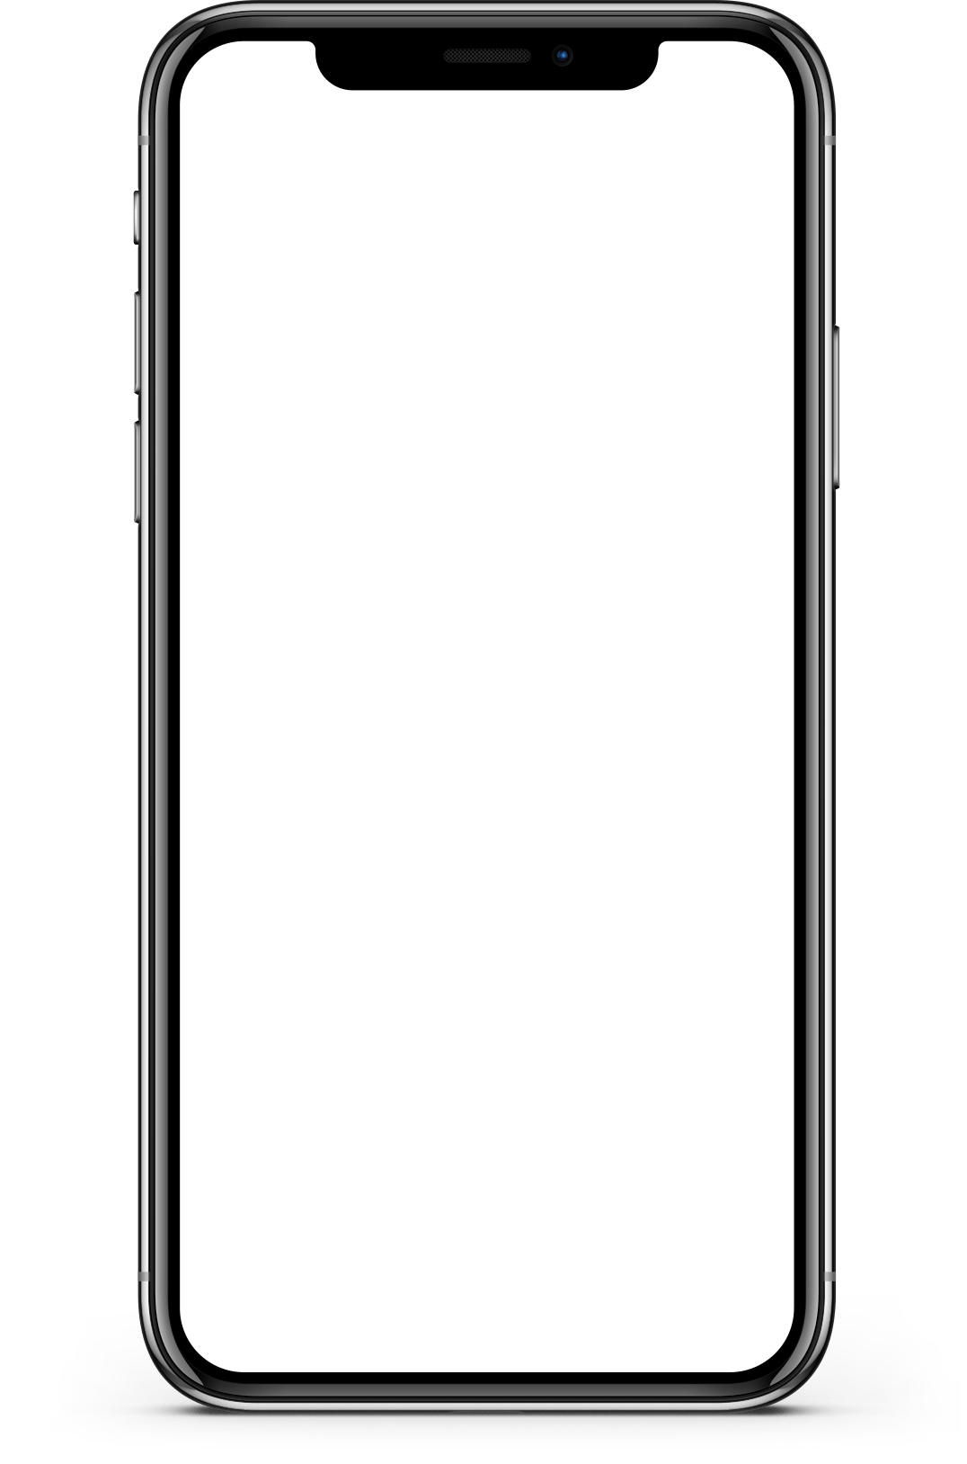
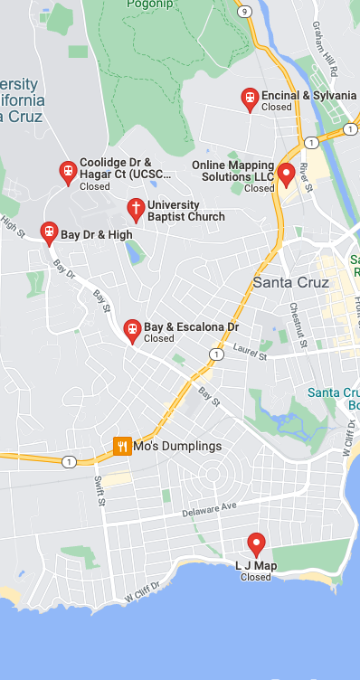
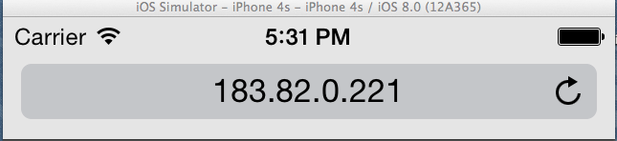

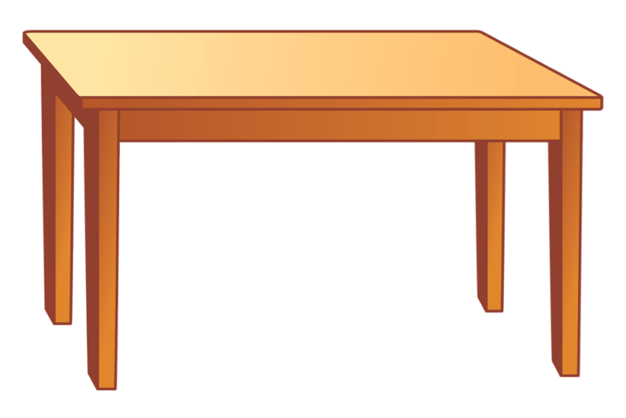

Architecture
Initial View
Table View
Visit Table Profile

Slide 9

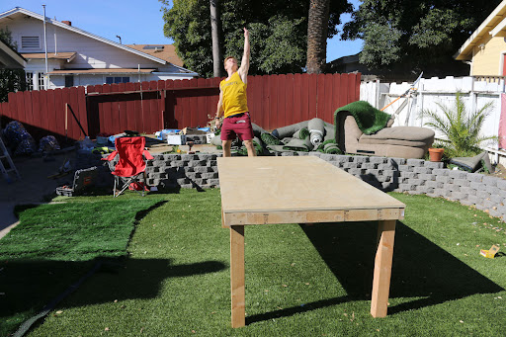
Architecture
House Table
Visit Table Profile
House Rules

Slide 10
Technologies
[Technology 1] Map Framework - Google API
[Technology 2] Website Formatting / Framework - HTML / PHP / CSS
[Technology 3] Database Framework - MySQL / Python

Slide 11
Challenges/Risks
[Challenge/Risk 1] Mapping Complications
Loading Map / Locational Issues / Uploading Map Markers
[Challenge/Risk 2] Unfamiliar technology - PHP, MySQL
[Challenge/Risk 3] User Profiles - knowing who you’re inviting
…

Slide 12
Minimum Viable Product
(MVP)
At a minimum, our app should be capable of listing tables on a map - allowing users to request to play at those tables in the app. Users should be able to create a table profile, including features such as house rules.
“As a dye player, I want to be able to see dye games around me, so that I can play more.”
“As a table owner, I want the ability to post public marked locations, so I can show that I have a table available.”
“As a dye player, I want the map centered around my location, so it will be easier to find games around me”
“As a table owner, I want to be able to attach a table profile to a location on a map.”
“As a table owner, I want to be able to attach a set of rules to a table post on a map.”
“As a table owner, I want to be able to attach a picture of my table to my post on a map”

